Slide 1
Distributed Programming and Networking – AA 2020/2021
“An online platform to consult with Ophthalmologists, Optometrists, and Opticians”
Authors: Marya Ryspayeva, S M Ragib Shahriar, Ebaneo Enrique Valdez Kao
(marya.ryspayeva@studentmail.unicas.it , smragibshahriar.islam@studentmail.unicas.it, ebaneoenrique.valdezkao@studentmail.unicas.it)

Slide 2
Outline
Abstract (500 words maximum)
Mockup of the application with a brief description
Client side languages, environment and technologies
Server side languages, environment and teghnologies
Timetable (hint: SCRUM framework, https://www.scrum.org/ )

Slide 3
Abstract
An online platform to consult with Ophthalmologists, Optometrists, and Opticians.”
The project represents the system for Eye medical center to communicate with patients and doctors automatically. The system includes a landing page with three sections: appointment form, list of doctors, and pricing.
There are three roles: admin, doctors, and patients. They can log in and register through the form of authorization and registration. After registration, all of them can use a personal cabinet.
Any doctor can login and compose individual schedules for workdays. He will see when and what patient has been recorded for the appointment and form a day schedule. The following function is to create a patient record after medical examination and upload the retinal photo for further segmentation. After getting the segmentation results, the doctor can send the report to the patient. The doctor will be able to view the list of his patients and booked appointments. A digital signature for doctors will help to issue online diagnostic reports. It will contain a QR code. So, if anybody wants to verify the information, they can only scan it and go to the portal (to avoid fraudulent behavior).
Patients will be able to make an appointment and chose any doctor from the list. After that, the system will suggest that they register and log in if the patients were not recorded. After authentication, patients also have a personal cabinet, where they can view their report, download or print it, and see the status of analyzing the image: in progress / ready.
Administrators will manage by doctors and patients roles, precisely, to control patient/doctors records and edit records of patients/doctors. As an additional function, administrators will be able to download an anonymous dataset with reports description, photos, and diagnoses for researches. Doctors and patients will be able to restore the usernames and passwords and confirm them by email.

Slide 4
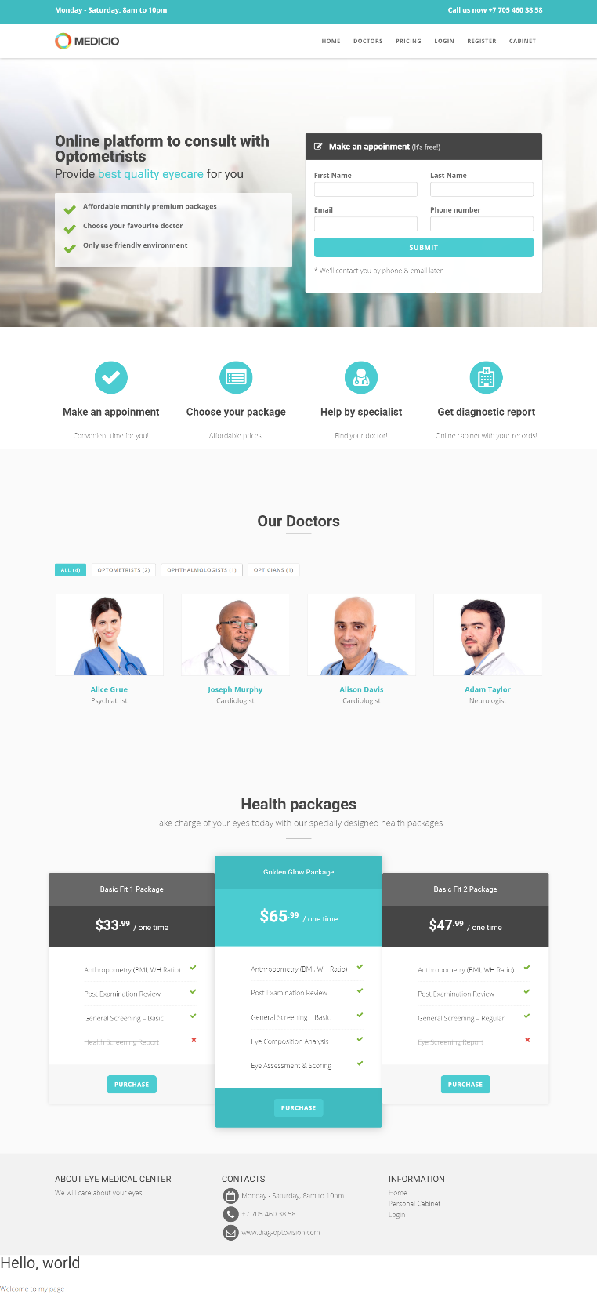
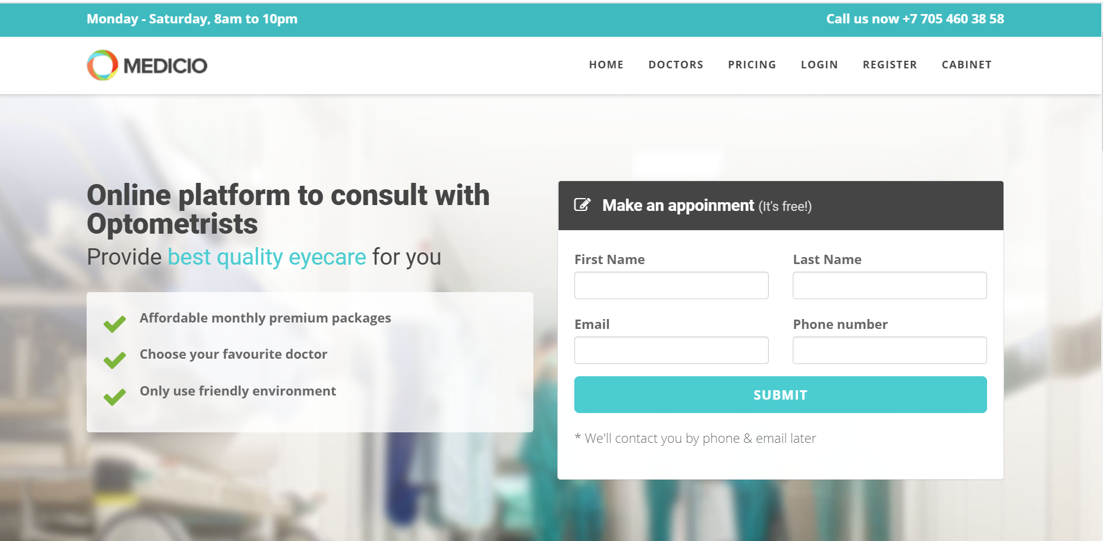
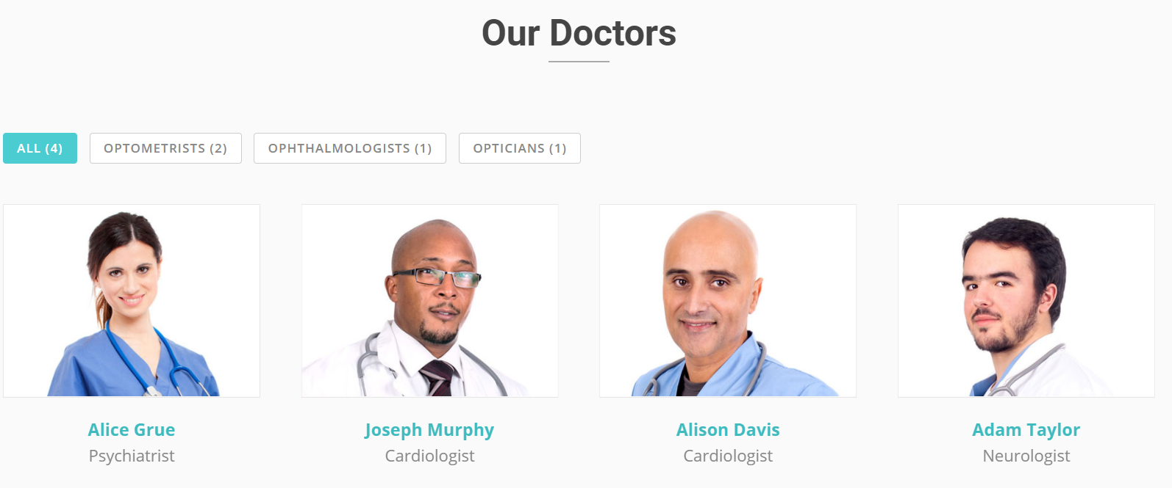
Screenshots of landing page

Slide 5
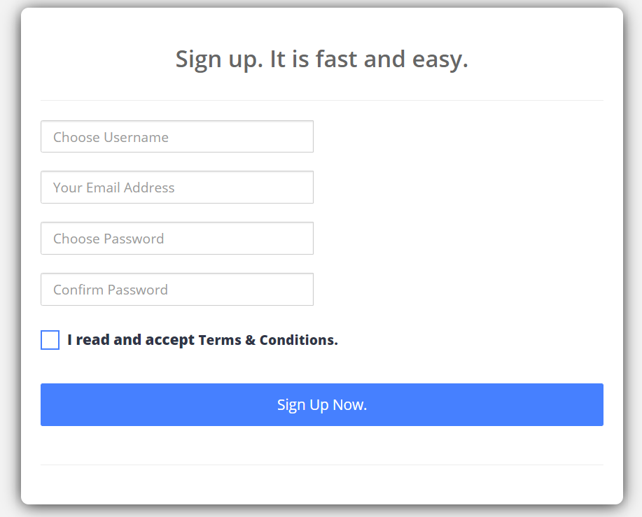
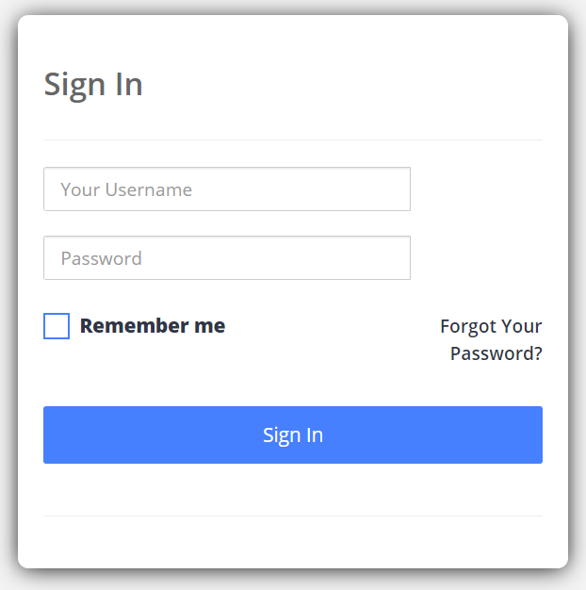
Mockup
Login (Must have)
Doctors and patients can login and register using forms of authentication and registration

Slide 6
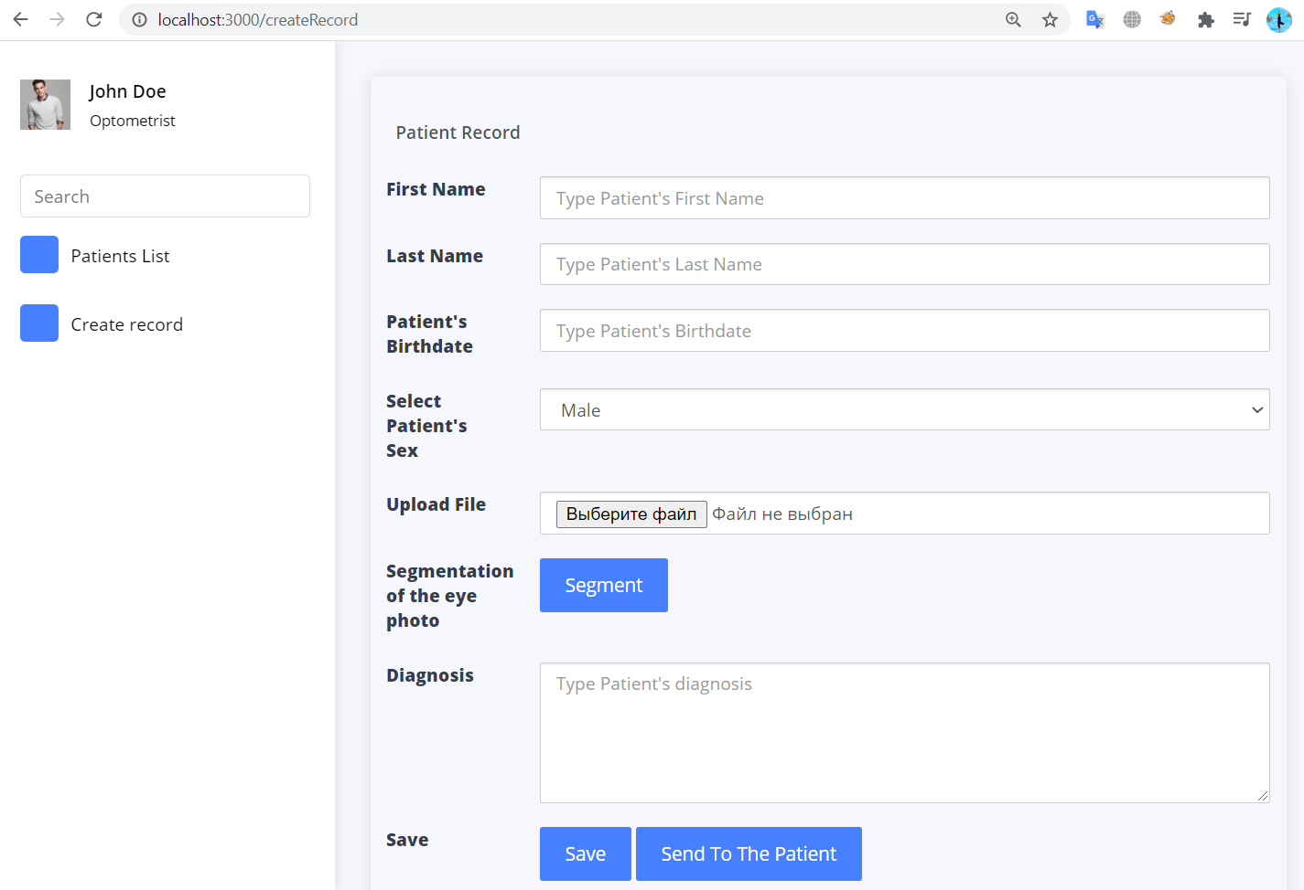
Mockup
Upload of multimedia (Must have)
Doctor Role:
to register/login as a doctor,
to create a patient report,
upload patient's eye photo,
to segment uploaded file,
to send this report to a patient.
Patient role:
to register/login as a patient,
to see the doctor's report.
Admin role:
to control patient / doctors records,
to edit records of patients / doctors

Slide 7

Video

Slide 8
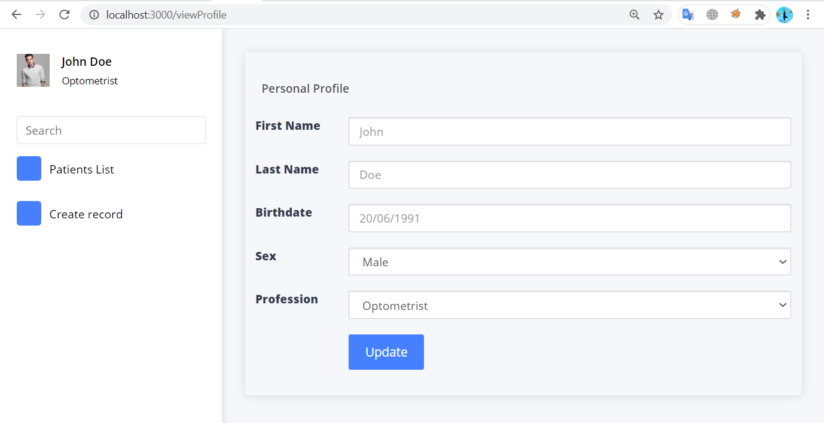
Mockup
User info update (Should have)
Doctors:
to create a personal schedule,
to send a report to the patient with notifications (like telegram notifications)
to recover forgotten password
to see booked appointments and form schedule for a day.
Patients:
to make an appointment with different doctors on the site.
to print a ready report
Admins:
to form an anonymous dataset with report description
to download this dataset for studying
Update of personal information in the Doctor cabinet

Slide 9
Mockup
Could have
registration of doctors and patients with confirmation by email
to see the status of the analyzing the image: in progress / ready
to secure all records with block chain technology :)
to add payment portals for the patients and also membership facilities for patients (if they want to have regular checkups)
percentage score matrix to evaluate and show the patient the status of their vision.
To add a digital signature feature for doctors, so that they can issue online diagnostic reports. It will contain a QR code. So, if anybody wants to verify the report can only scan it and go to the portal(To avoid fraudulent behavior.).

Slide 10
Client side
Languages, environment and technologies
Javascript
JSON
HTML, CSS, JQuery

Slide 11
Server side
Languages, environment and technologies
Firebase
Node.js
MongoDB
Etc.

Slide 12
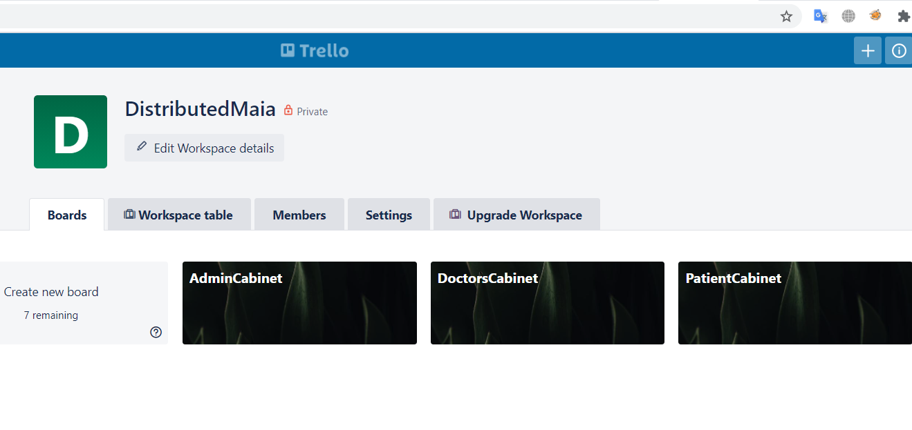
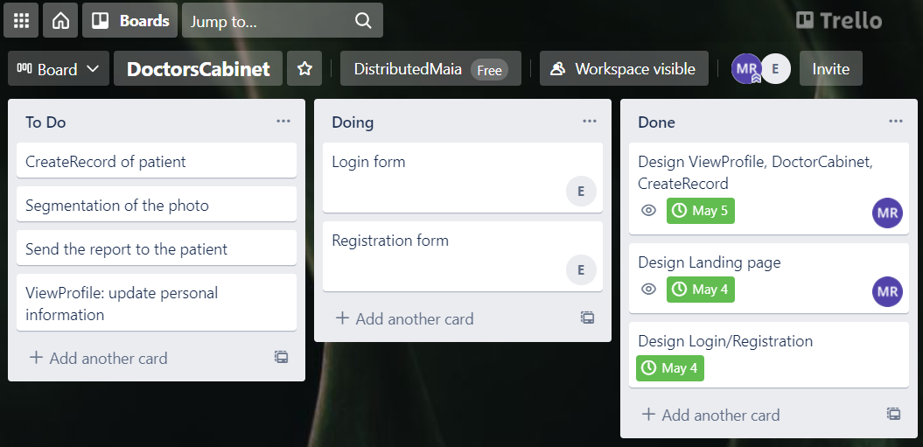
Timetable

Slide 13
Thank you
FOR YOUR ATTENTION

